Slide 1
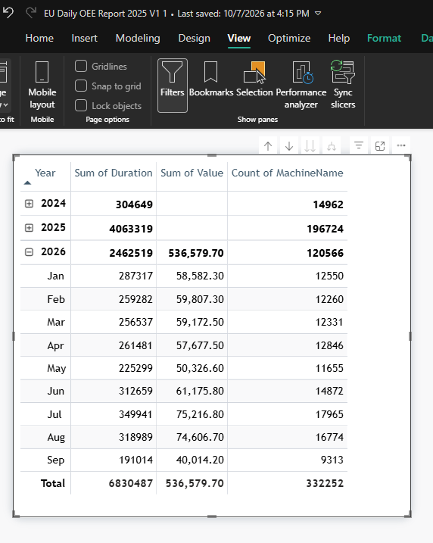
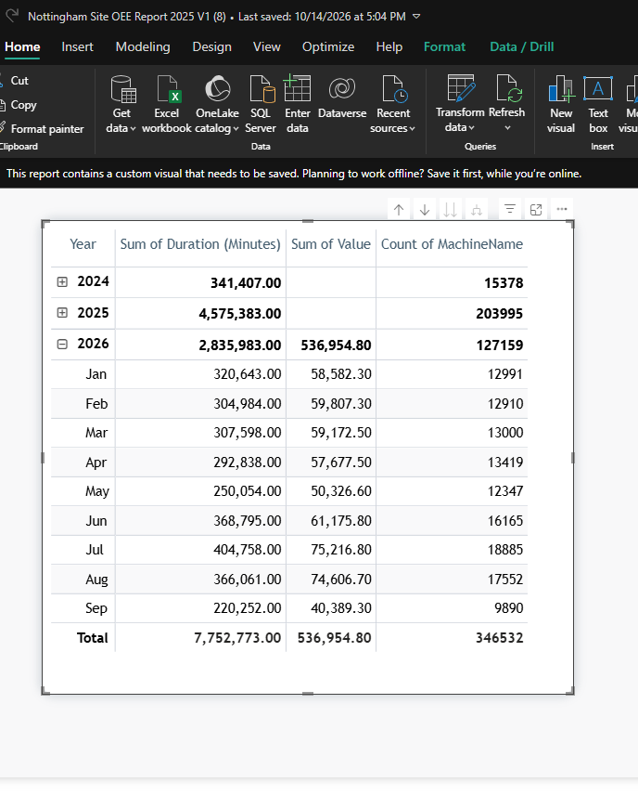
EU on Nottingham DATA FILTER
Before 15/09/2026
Nottingham DATA FILTER
Before 15/09/2026

Slide 2
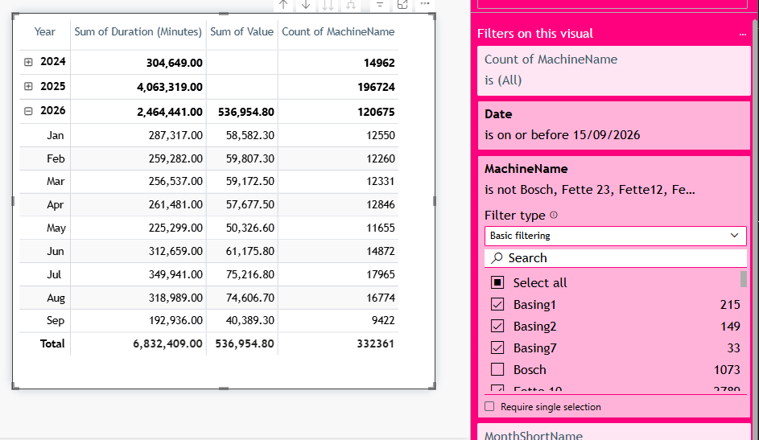
EU on Nottingham DATA FILTER
Before 15/09/2026
Nottingham DATA FILTER
Before 15/09/2026
If this is out:
Bosch, Fette 23, Fette12, Fette2, Fette20, Fette4, Fette5, Gran0, S14

Slide 3
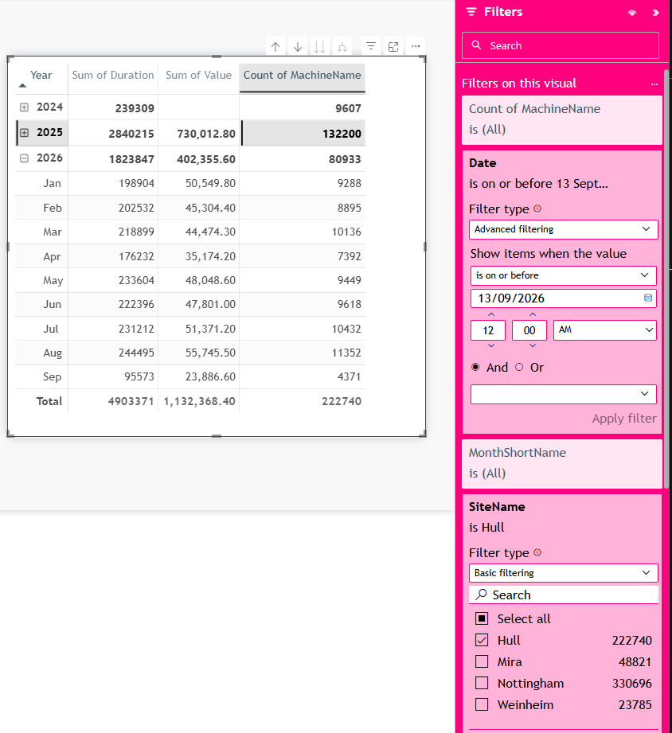
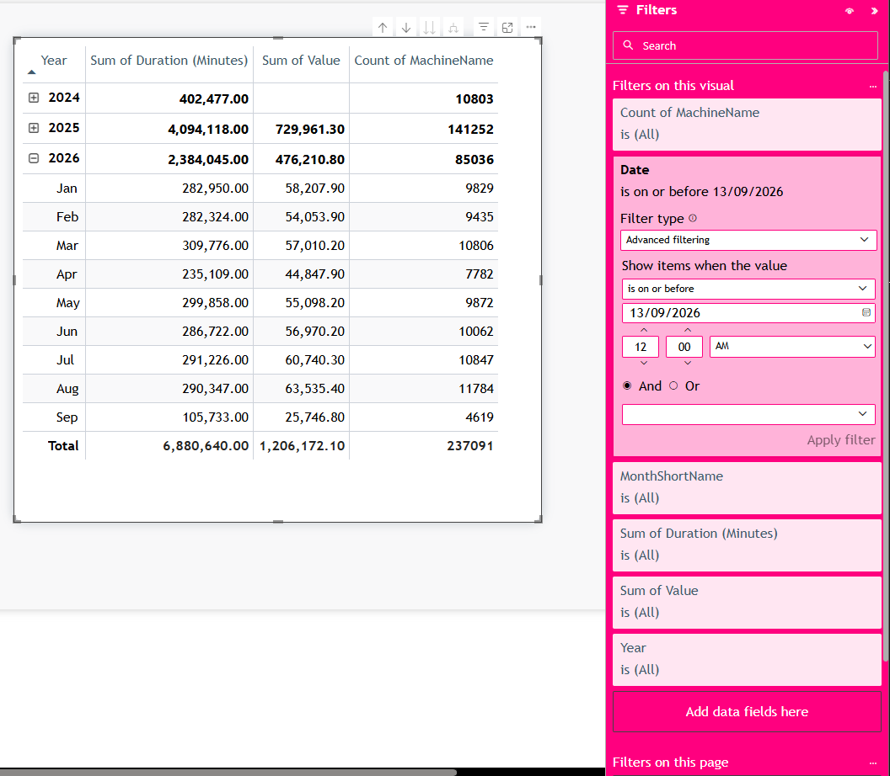
EU on HULL FILTER
Before 13/09/2026
HULL DATA FILTER
Before 15/09/2026

Slide 4
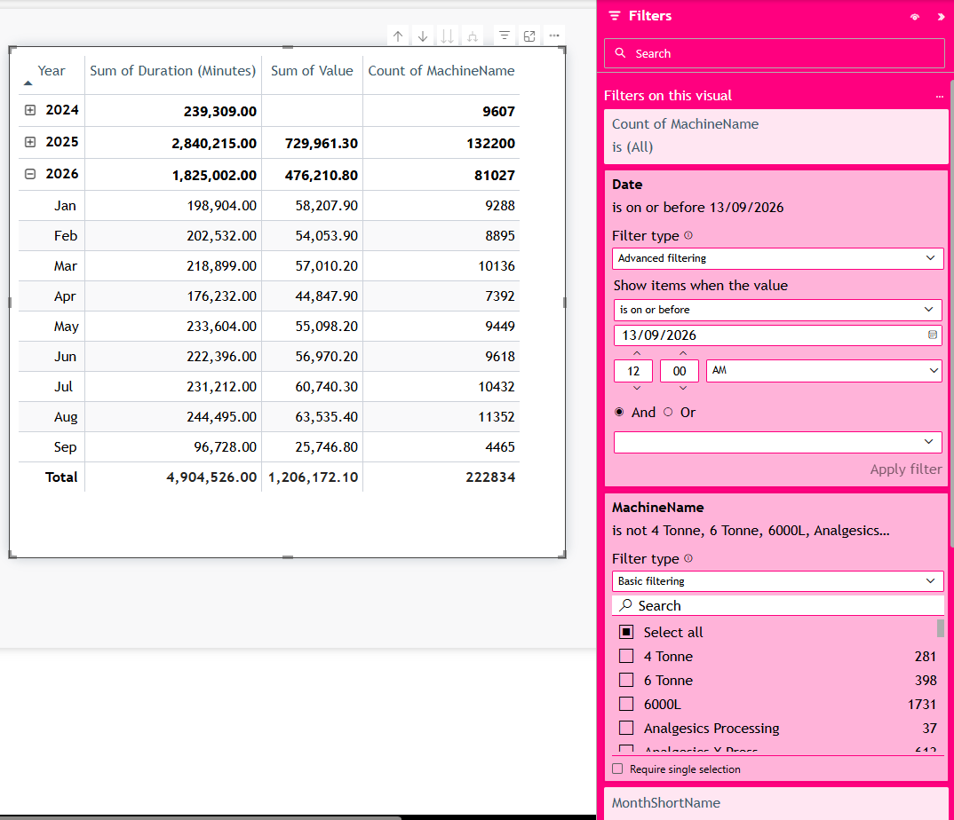
EU on HULL FILTER
Before 13/09/2026
HULL DATA FILTER
Before 13/09/2026
If this is out:
4 Tonne, 6 Tonne, 6000L, Analgesics Processing, Analgesics X Press, Bosch Capsulator, Dettol 1, Evolution, Fitten, Gaviscon TPR, Gaviscon XP700(A), GG4, GG5, GG6, GG7, Lemsip Process, Senokot Press, Symex suite, Vacumix

